Slide 1
JAM ON!!
by Braydon Spangler

Slide 2
Concept
Guitar Hero-style rhythm game
2-3 song options at start, more can be added in the future
Each song would require an audio file to play during the game and a ‘beat track’ to follow
Player would use 5 keys to play different notes of the song’s beat track while it plays
Failure to successfully press the key sync’d to the reduces the song performance
After the song is finished, the game shows the player the number of missed keys and % hit
Top 3 percent high scores stored until game is shut down

Slide 3
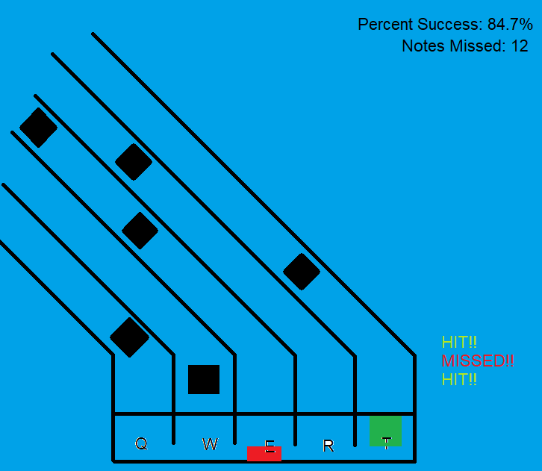
Concept Art

